Slide 1
#EMCLiberté

Slide 2
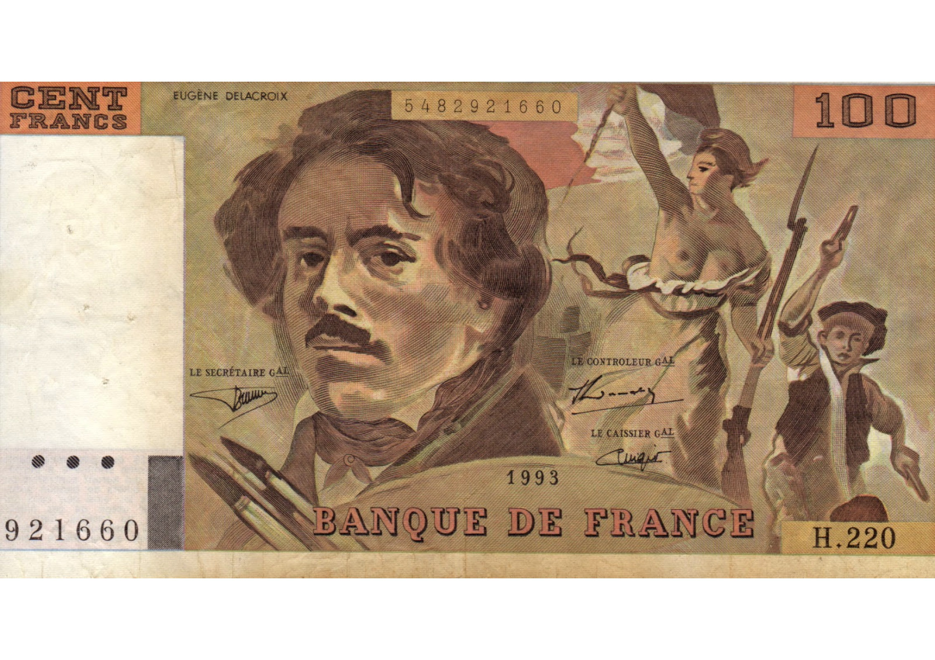

Slide 4
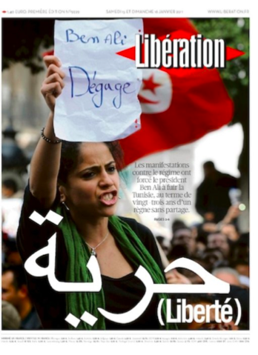

Slide 6
